Slide 1
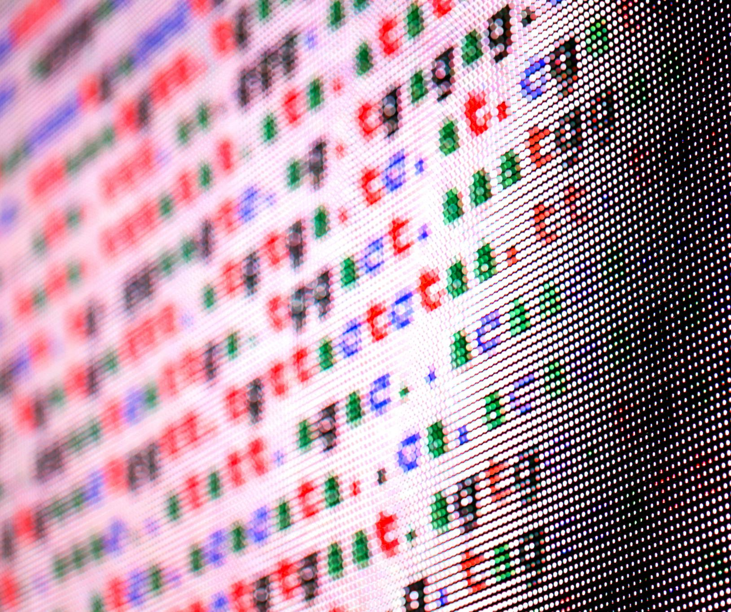
CIFAR-10
Deep Learning
Jayjit Pradhan
May, 2025

Slide 2

Agenda Items
Project & Problem Description
Data Description and Load
Data Clean-Up and EDA
Data Preprocessing
Model Build
Model Comparison
Summary

Slide 3

Project and Problem Description
As part of DTSA-5511 Introduction to Deep Learning course for Master of Science in Data Science from University of Colorado, Boulder, this project is done for classifying CIFAR-10 dataset using supervised machine learning algorithms
The CIFAR-10 dataset consists of 60000 32x32 color images in 10 classes, with 6000 images per class.
The classes are—
Airplane, Automobile, Ship, Truck
Bird, Cat, Deer, Dog, Frog, Horse

Slide 4
Data Description and Load

Slide 5
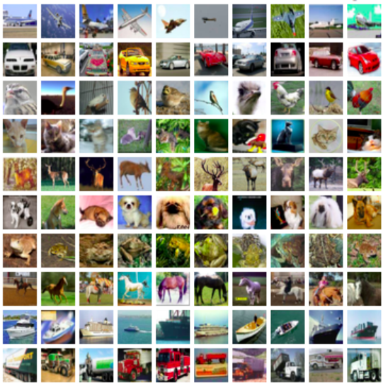
CIFAR-10 Dataset
Dataset Overview
CIFAR-10 consists of 60,000 images divided into 10 distinct classes for classification tasks.
Image Classes
Each class in the CIFAR-10 dataset contains 6,000 labeled images, facilitating robust training and testing of models. Each image in the CIFAR-10 dataset is 32x32 pixels in RGB format, making it suitable for various algorithms.
Benchmarking Tool
CIFAR-10 is widely used as a benchmark for evaluating machine learning algorithms in image classification tasks.
Keras Dataset
For this project CIFAR-10 dataset have been loaded from Keras Datasets.

Slide 6
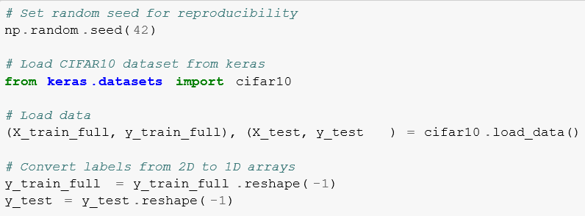
Loading CIFAR10 Dataset
Loading with Keras
To load CIFAR-10 dataset in Keras, I have used the function keras.datasets.cifar10.load_data().
Automatic Train-Test Split
This data load automatically splits the data in Train & Test batches of 50,000 & 10,000 images respectively.
Image Properties
Each image in the Train & test dataset is 32x32 pixels in RGB format, having a pixel value range from 0-255.

Slide 7
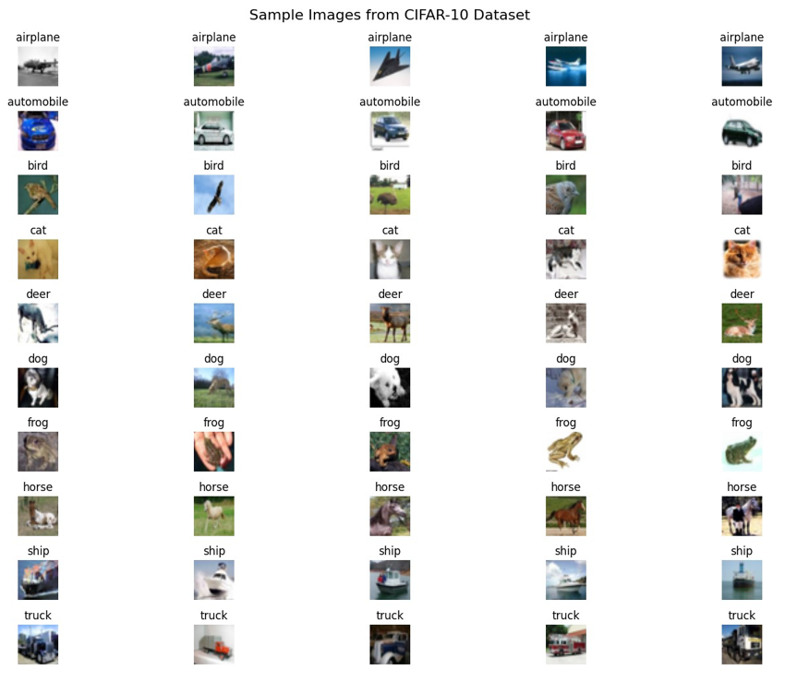
Sample Images from CIFAR-10

Slide 8
Data Clean-Up and EDA

Slide 9

Data Clean-up
No data clean-up are done on Keras CIFAR10 data as—
Pre-curated Dataset
CIFAR-10 is a well-established, carefully curated benchmark dataset that has already undergone quality control. Unlike real-world datasets, it doesn’t contain: Missing values, Corrupted images, Mislabeled samples or Inconsistent formatting
Uniform Image Properties
Each image in the Train & test dataset is 32x32 pixels in RGB format, having a pixel value range from 0-255.
Balanced Classes
CIFAR-10 has exactly 6,000 images per class (balanced distribution), so no class imbalance handling was required.
Nature of Image Data
Unlike tabular data, images typically don’t have issues like Outliers, Categorical value encoding, Date/time field conversions etc.

Slide 10
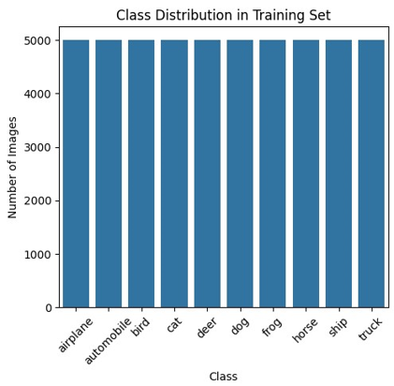
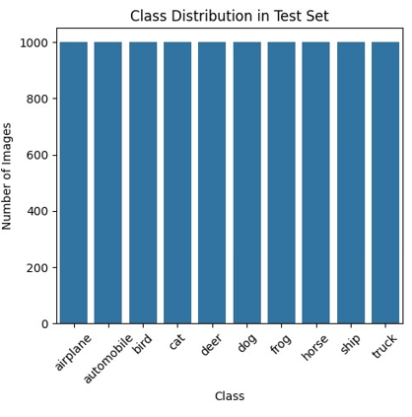
Class Distribution in CIFAR-10
Understanding the distribution of classes is crucial for model training.
Each class in CIFAR-10 contains 6,000 images. 5000 images in training set and 1000 images in test set.
Balance in class distribution helps in benchmarking model performance.

Slide 11
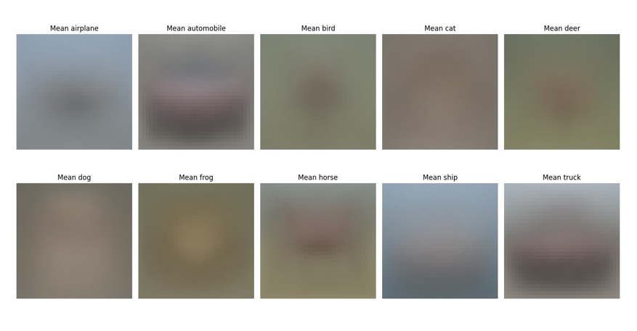
Visualizing Mean Images
Visualizing mean images per class highlights common features.
Mean images are computed by averaging pixel values.
Useful for identifying class-specific characteristics such as—
Mean airplane/ship images show a distinctive cruciform shape on a blue background
Mean automobile/truck images reveal horizontal shapes with visible wheel positions
Mean animal images (cats, dogs, deer) show basic body outlines with common postures –
The frog mean image typically shows a top-down view with a distinctive silhouette

Slide 12
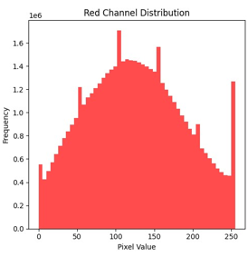
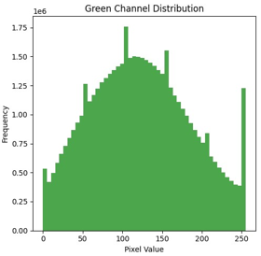
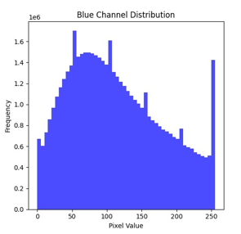
Pixel Value Distribution Analysis
Pixel values range from 0 to 255 in RGB images.
Understanding pixel value distribution aids in normalization.
Visual inspection show all the RGB channels have similar pixel value distribution.

Slide 13
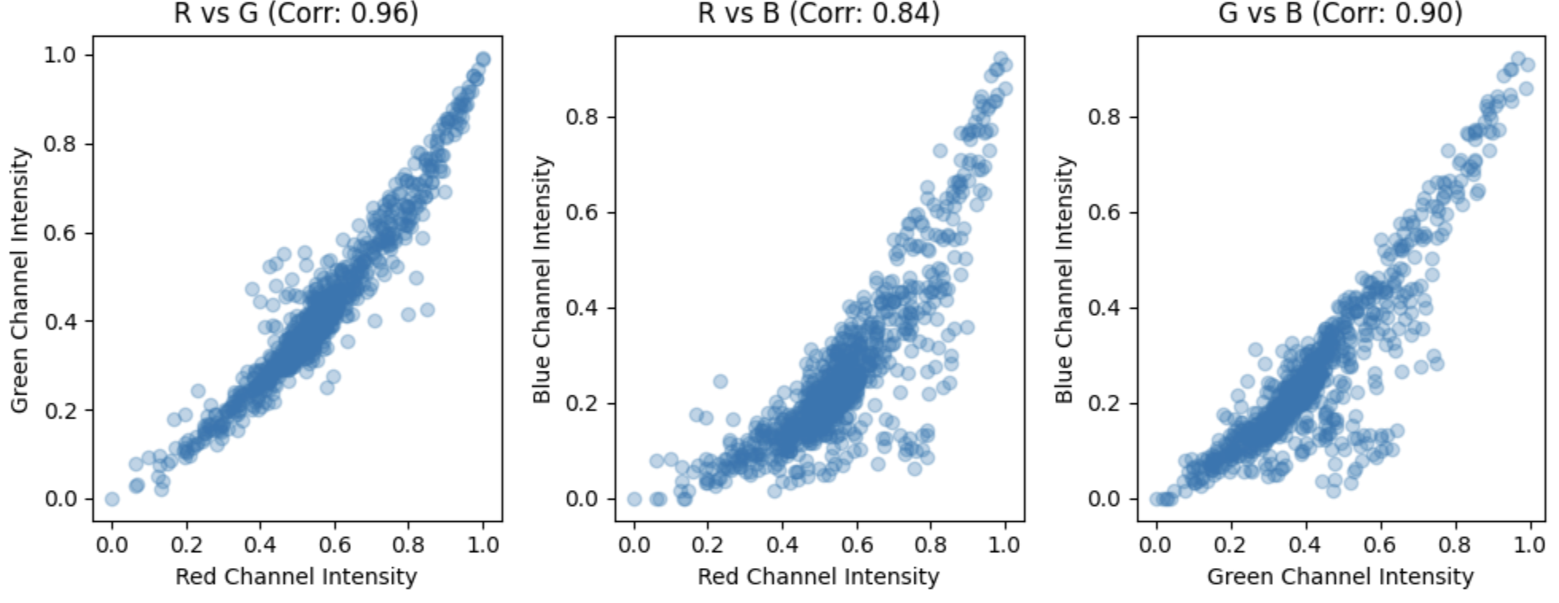
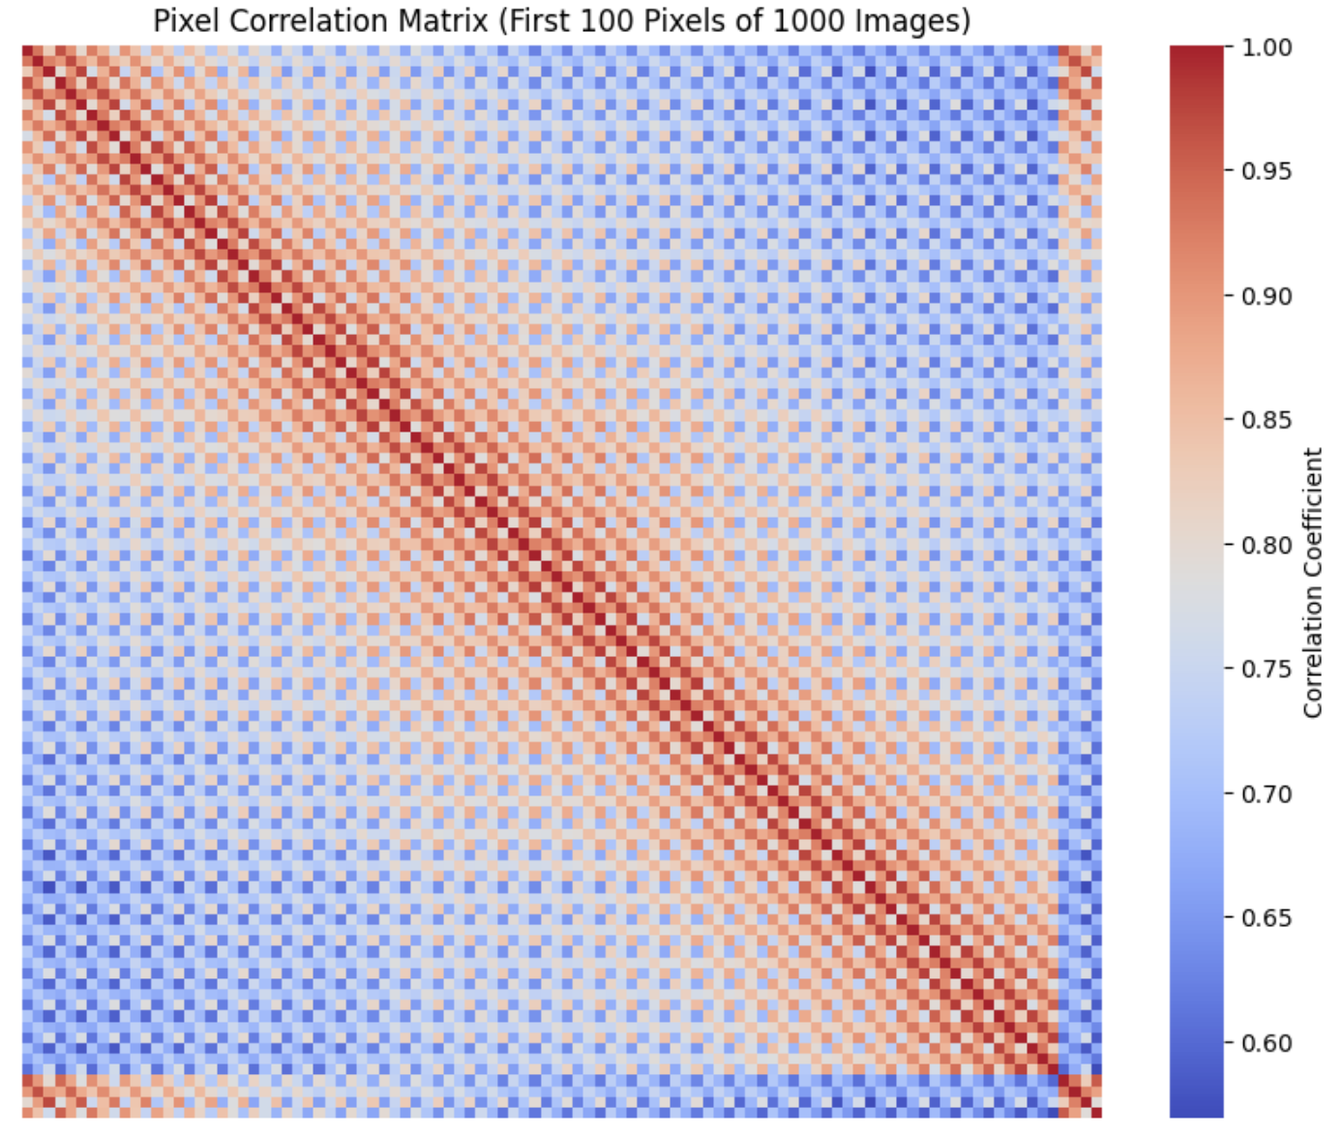
Pixel Value Correlation Analysis
High positive correlation between color channels suggest that the intensity values in these channels tend to vary together.
High positive correlation between nearby pixels is expected because neighboring pixels in an image often have similar color intensities.
Low correlation between distant pixels is also seen.

Slide 14
Data Preprocessing

Slide 15
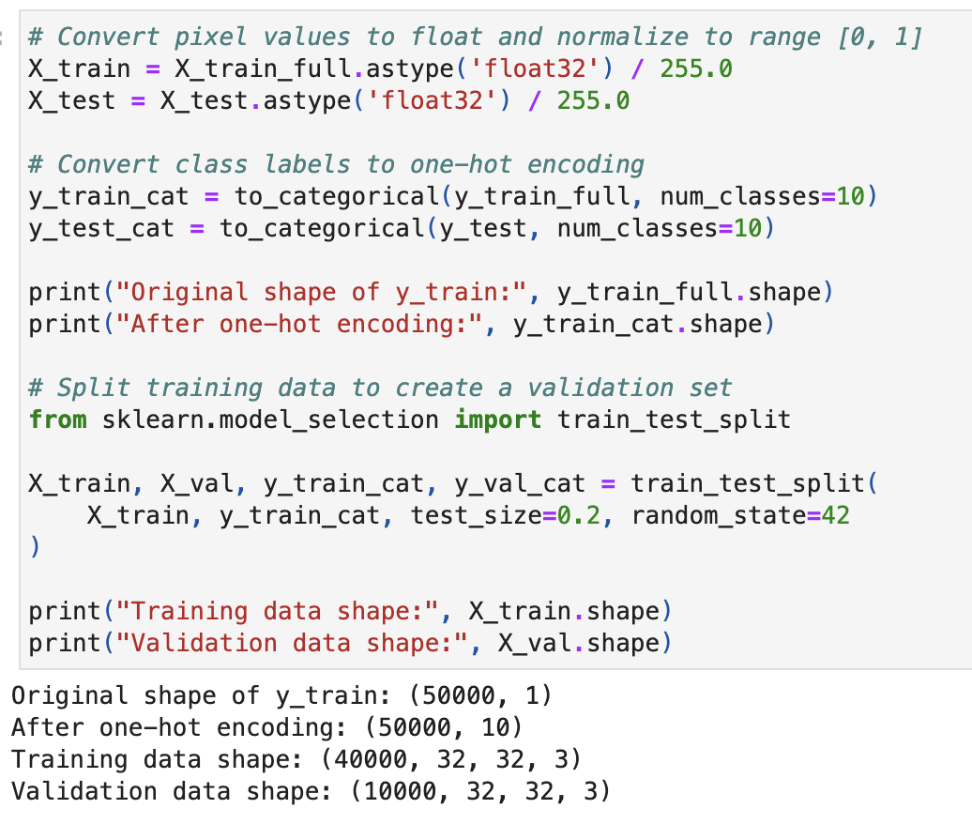
Train-Validation Split of Data
Pixel values in both train and test set have been normalized to range of [0, 1].
Class labels in both train and test set have been one-hot encoded.
Train set is further split into Validation set with 20% of data.
After splitting Train set contains 40000 images and Validation set contains 10000 images.

Slide 16
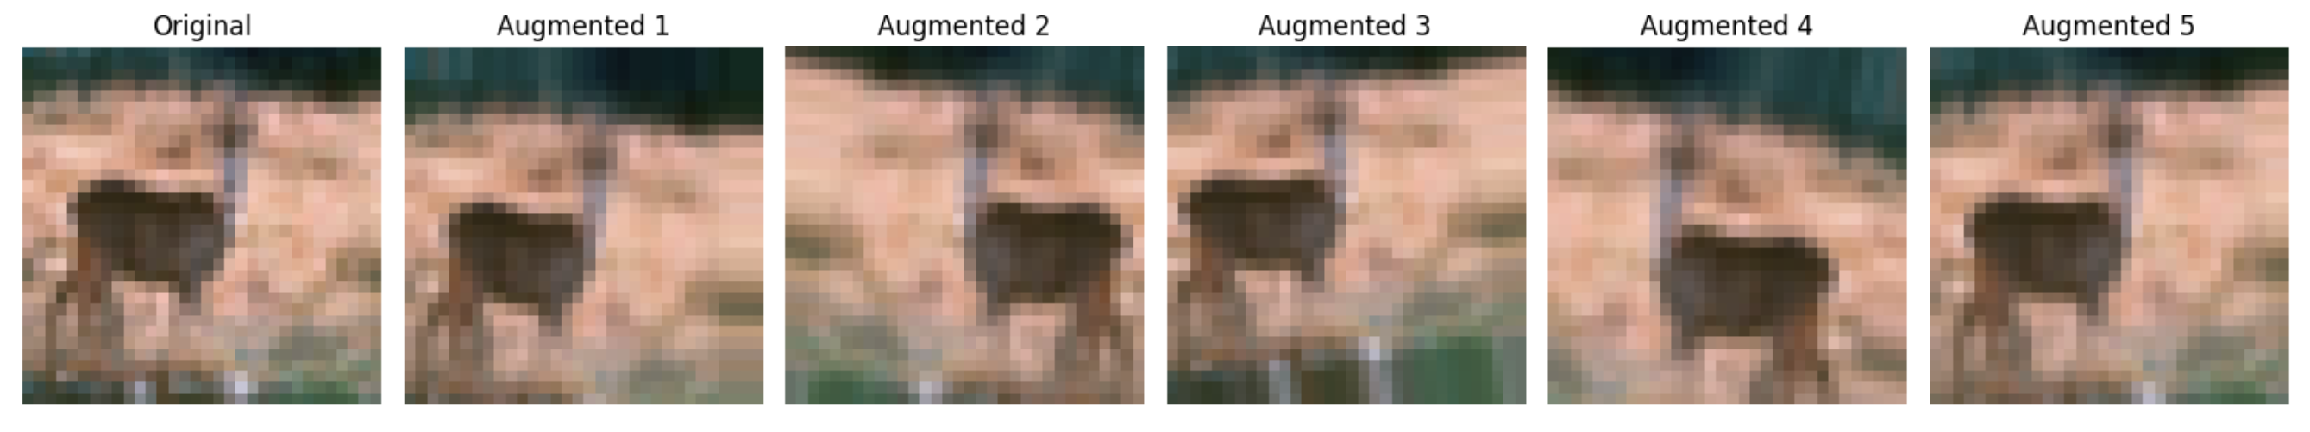
Data Augmentation
Data augmentation techniques involve creating new data points from existing ones to increase the size and diversity of a dataset, which can improve model performance and generalization.
By using horizontal flip, width & height range shifts and rotations, data augmentation is done on Train set.

Slide 17
Model Build

Slide 18
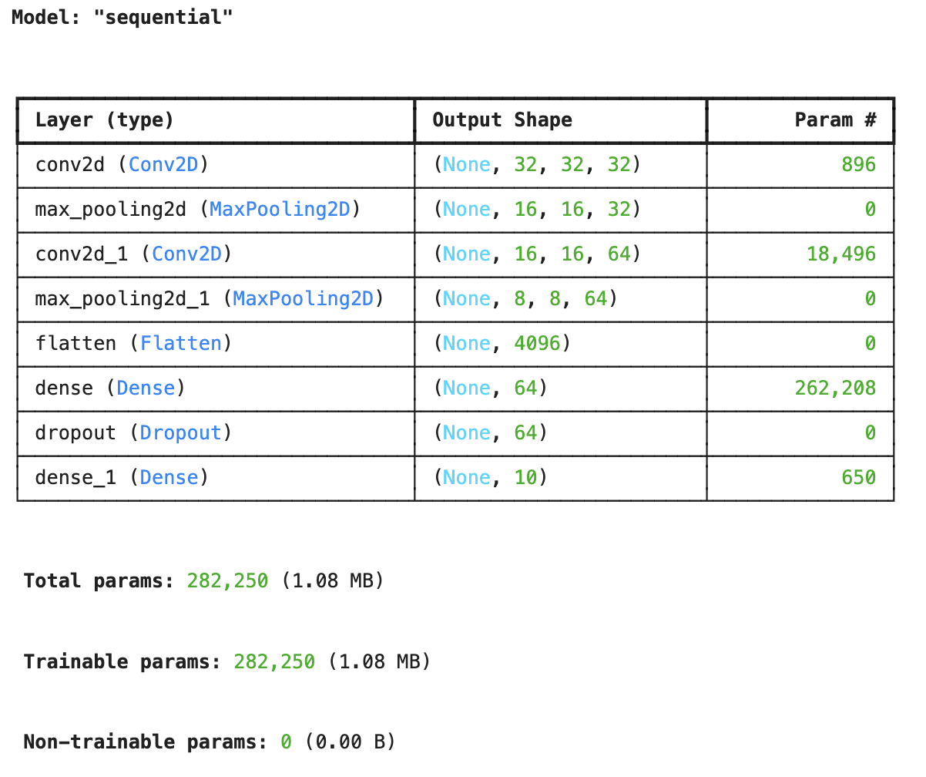
Baseline CNN Model
Convolutional Blocks
First Convolutional Block
32 convolutional filters with 3×3 kernel size, ReLU activation function, ’same' padding to preserve spatial dimensions
2×2 max pooling, reducing dimensions to 16×16
Second Convolutional Block
64 convolutional filters with 3×3 kernel size, ReLU activation function,'same' padding to preserve spatial dimensions
2×2 max pooling, reducing dimensions to 8×8
Classification Layers
Flatten Layer : Transforms the 8×8×64 feature maps into a 4,096-dimension vector.
Dense Hidden Layer
64 neurons with ReLU activation
Creates a compact representation of extracted features
Dropout Layer
Rate of 0.5 (50% of neurons randomly deactivated during training)
Prevents overfitting by forcing network redundancy
Output Layer
10 neurons (one per CIFAR-10 class)
Softmax activation for probability distribution across classes

Slide 19

Training & Validating Models
Model Configuration
Using Categorical crossentropy as Loss function and Adam as optimizer for training Baseline CNN Model.
Training Models
Baseline Model training is done with 50 epochs with an early stopping on validation accuracy with patience as 5 and reduce learning rate on plateau with patience as 5 on validation loss.
Performance Matrix
Accuracy score provides a fair and straightforward assessment of the model’s performances since all classes contribute equally to the performance metric, without biasing results toward any class.
Validating Models
Using 20% of training data as Validation set, model’s performances are measured.
Hyperparameter Tuning
Baseline CNN Model is evaluated with below hyperparameter combinations—
Learning rates: 0.001 and 0.0001
Batch sizes: 64 and 128
Dropout rates: 0.25 and 0.5

Slide 20
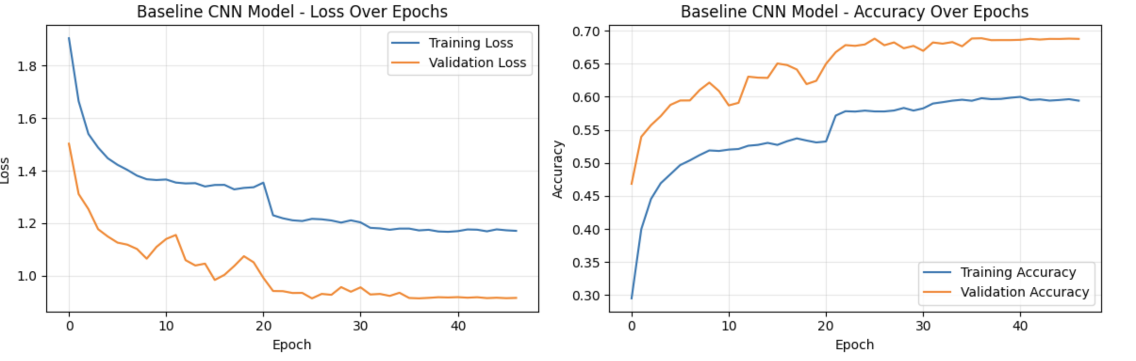
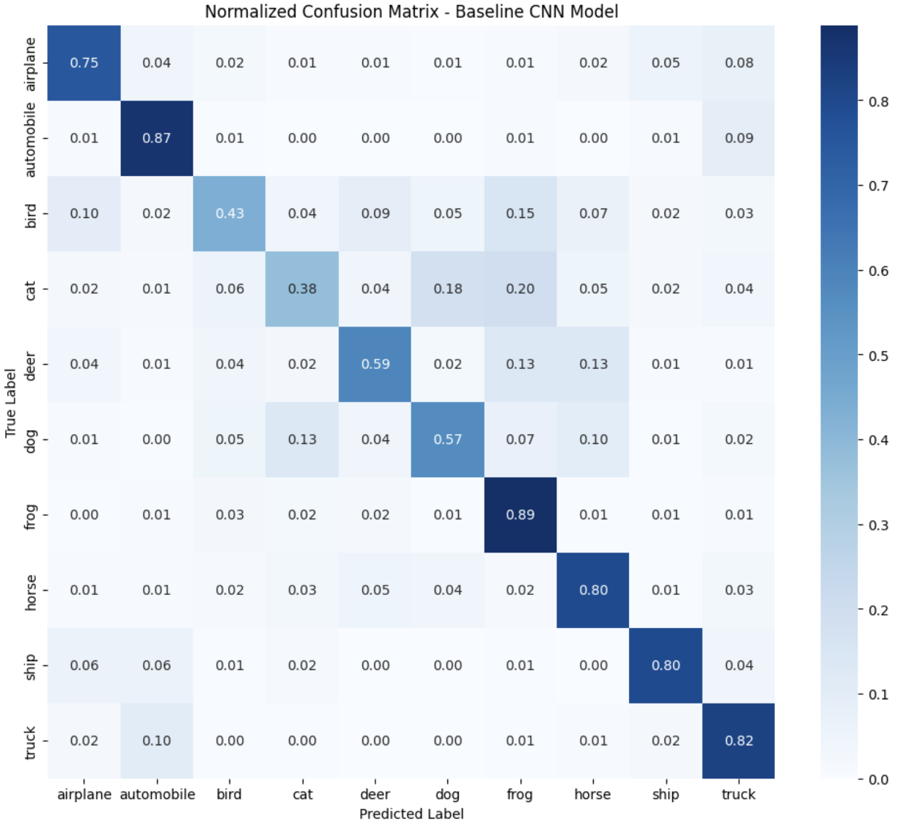
Model Metrics & Evaluation
Best Epoch
After training Baseline CNN model the best epoch is 26 with training loss as 0.9137 and accuracy of 68.80%.
Validation Data Metrics
On the validation set Baseline CNN model provided below metrics—
Accuracy score: 0.6886
Precision score: 0.6878
Recall score: 0.6886
F1 Score: 0.6786
Confusion Matrix
Confusion Matrix show model was most confused between cat & frog images followed by cat & dog, bird & frog and deer & flog.

Slide 21
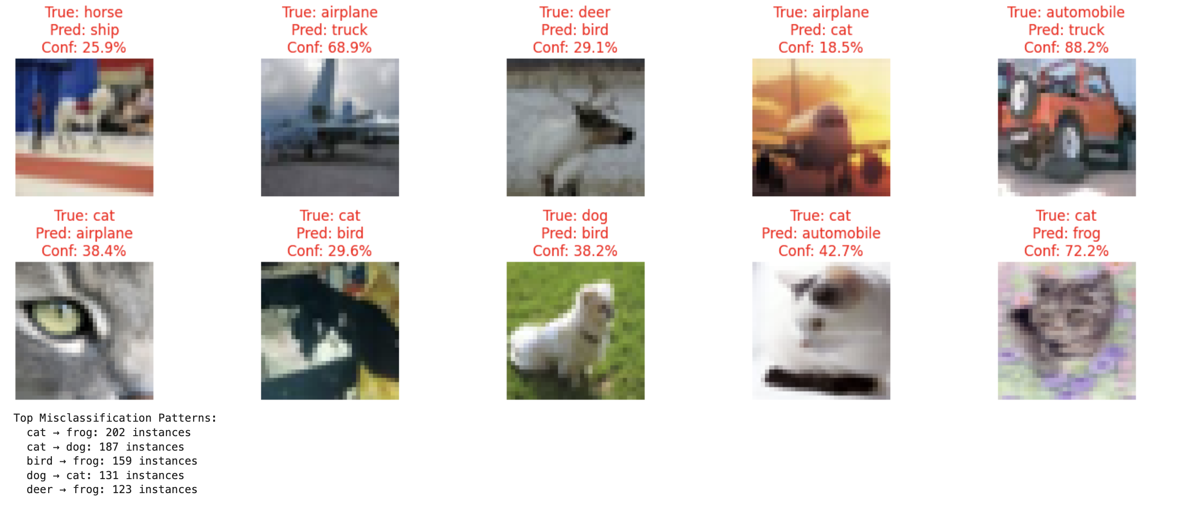
Misclassified Samples on Training Set

Slide 22
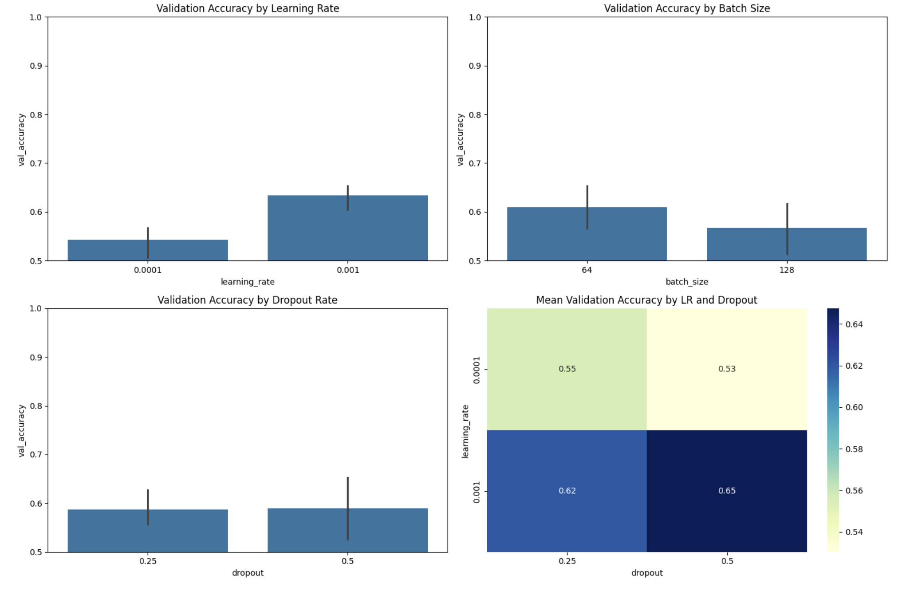
Hyperparameter Tuning
Hyperparameter Tuning Combinations
Baseline CNN Model is evaluated with below hyperparameter combinations—
Learning rates: 0.001 and 0.0001
Batch sizes: 64 and 128
Dropout rates: 0.25 and 0.5
Best Parameter Combination
With hyperparameter tuning the best combination is learning rate of 0.001, batch size of 64 and dropout of 0.5.
Validation Accuracy
With hyperparameter tuning, the baseline CNN model provided a validation accuracy of 65.72%.

Slide 23
Model Compare

Slide 24
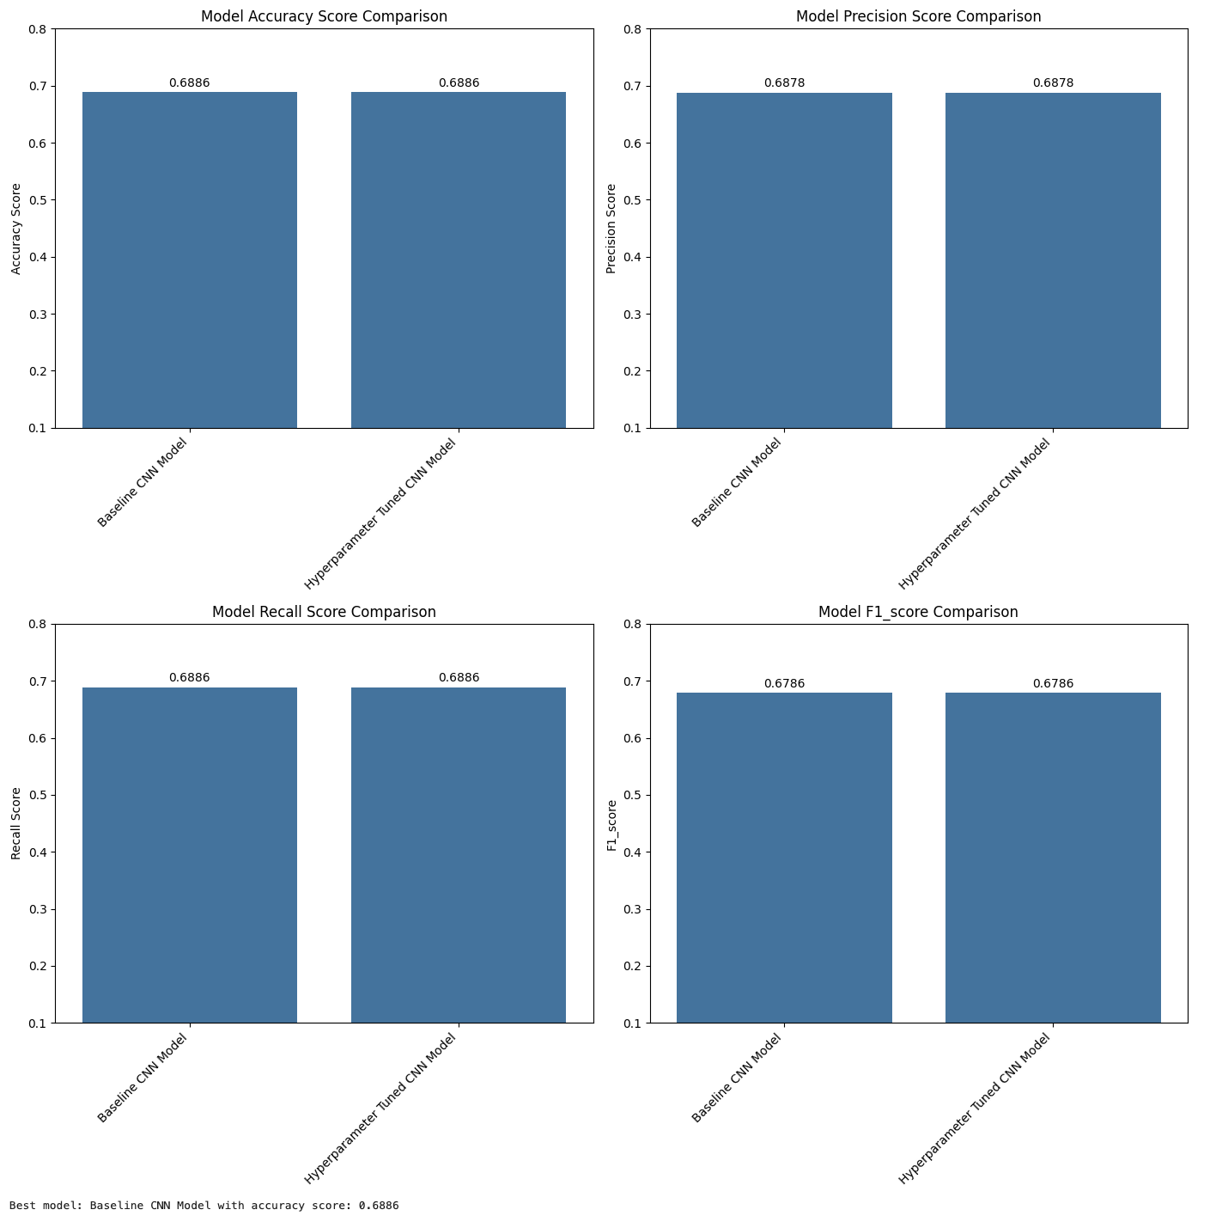
Comparing Model Performances
Evaluation Metrics
Using Accuracy score in validation set model performance is compared.
Visualizing Results
Looking at the results it is evident that Baseline CNN model and Hyperparameter Tuned CNN model is same and provided similar performances.

Slide 25
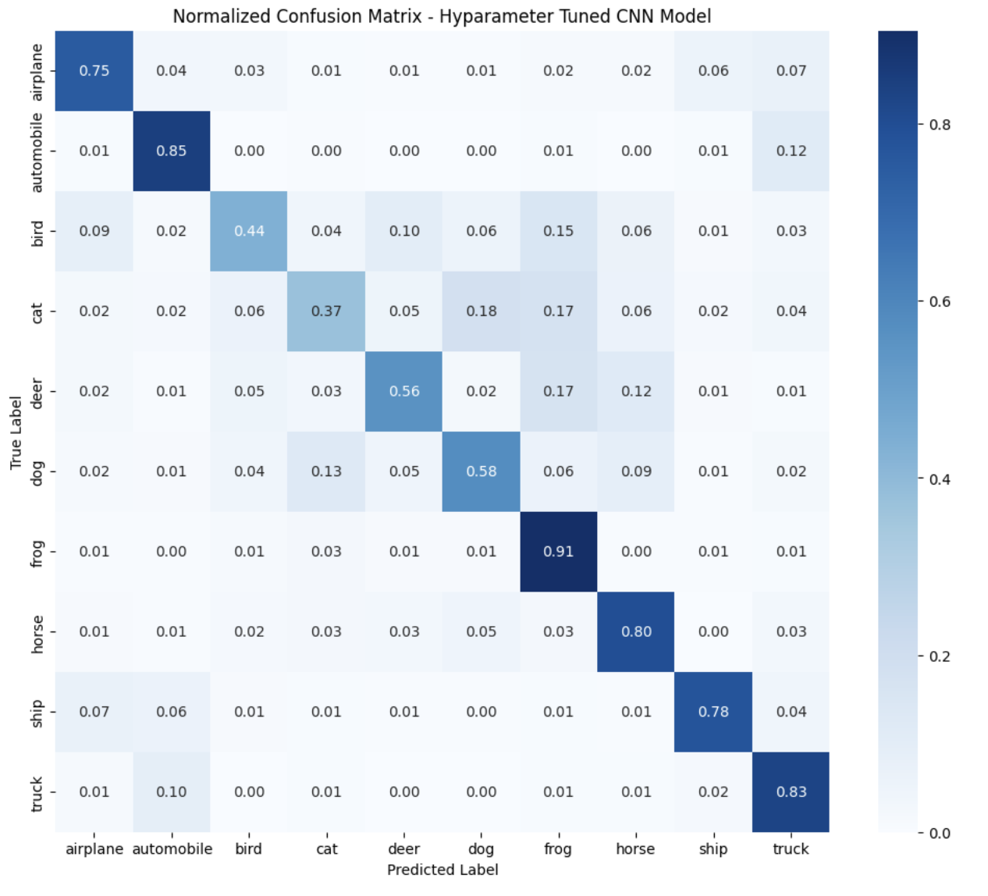
Best Model Validation on Test set
Accuracy Score
With the test set hyperparameter tuned CNN model gave accuracy_score of 0.6856 suggesting no overfitting or underfitting.
Confusion Matrix
Confusion Matrix shows model is most confused between cat & frog images followed by cat & dog and bird & frog.

Slide 26
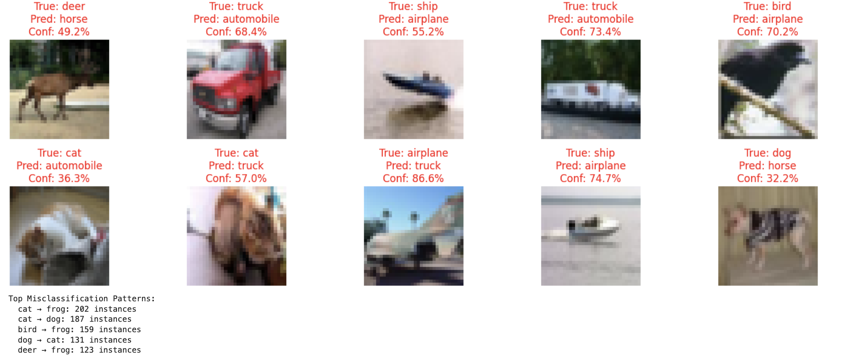
Misclassified Samples

Slide 27
Summary

Slide 28

Analysis of Model Performance
Based on my experiments with the CIFAR-10 dataset, I can draw the following conclusions:
Model Performance:
The baseline CNN model achieved a test accuracy of approximately 68%. The hyperparameter tuned model also achieved a test accuracy of approximately 68%.
Class-specific Performance:
Both models performed best on classes with distinct features like 'airplane', 'automobile', and ‘ship'. The most challenging classes were cat, dog, deer, bird, likely due to their visual similarity.
Training Dynamics:
The baseline model converged more quickly and showed better generalization. Data augmentation proved effective in reducing overfitting for both models.

Slide 29

Future Work and Improvements
1. Experiment with more advanced architectures like EfficientNet or Vision Transformers.
2. Apply transfer learning using models pre-trained on larger datasets like ImageNet.
3. Implement more sophisticated data augmentation techniques like CutMix or AutoAugment.
4. Explore ensemble methods to further improve accuracy.
5. Investigate model interpretability techniques to understand what features the model is using for classification.
6. Test model robustness against adversarial examples and common image distortions.

Slide 30

Conclusion
Deep learning algorithms show good results on CIFAR-10.
Baseline CNN Model was the top-performing model in our study.
Validation accuracy achieved was approximately 68%.
Test accuracy was around 68%.
Further research can improve these outcomes.

